Slide 1
LUNG CANCER Prediction using Machine learning models
DATA 606 - Capstone in Data Science

Slide 2
Introduction
Lung Cancer is categorized as the third most common cancer in the United States. The statistics state that more people die from Lung Cancer than any other type of cancer.
We will be using a dataset that includes various details about the lung cancer tests conducted, the type of cancer reported (benign or malignant), the lifestyle of lung cancer patients, and their gender.
The machine learning models if adopted by medical organizations will help in the diagnosis of cancer and early detection of disease in many cases. We will be implementing the models on our dataset and suggest the best suitable model based on the accuracy.

Slide 3
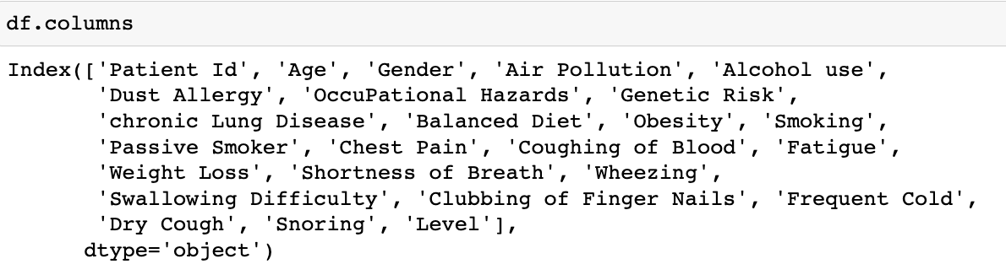
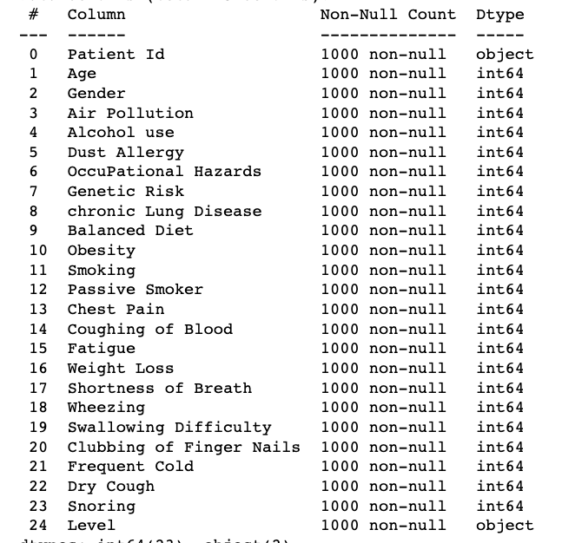
Data Source Details
The data set is considered from Kaggle: https://www.kaggle.com/rishidamarla/cancer-patients-data.
The data set contains 25 columns and 1000 rows.
There are no null values in the dataset and the datatype is an integer for all the columns.
Dropped the column Patient ID as a part of the initial analysis, as we are not going to use that column for our analysis.

Slide 4
Hypothesis
Identify whether the risk of being affected by lung cancer is higher in Men or Women(gender comparison of data)
Does smoking frequency lead to a higher rate of getting affected?
Do older adults affect with cancer experience tendencies of weight loss, shortness of breath, and fatigue?

Slide 5
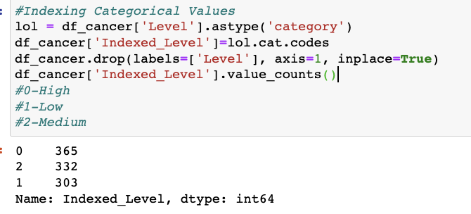
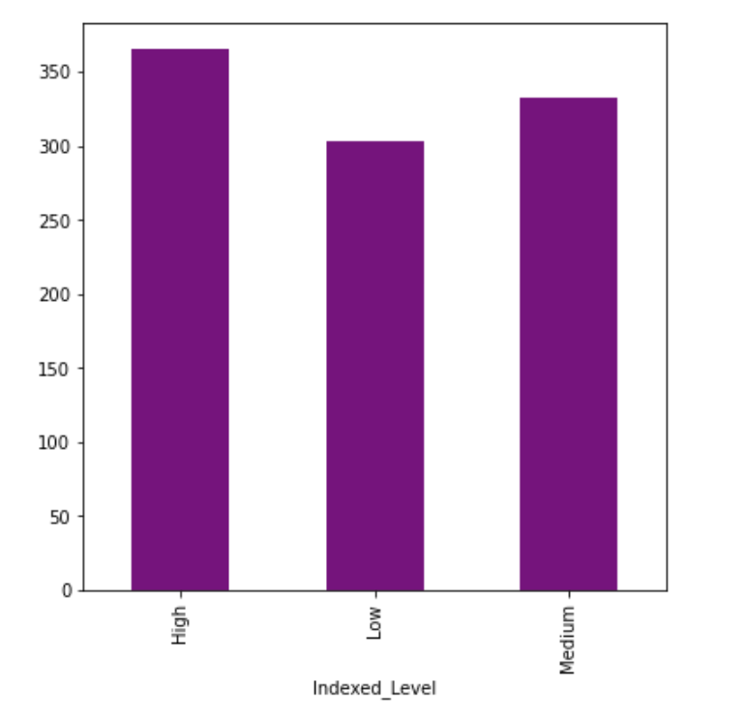
Visualizing the Indexed Categorical Values
Indexing of categorical values
Bar Plot: We tried to plot the indexed level values from the dataset using a bar chart to understand the level using the high, medium, and low specifications for the values 0,1, and 2 respectively.

Slide 6
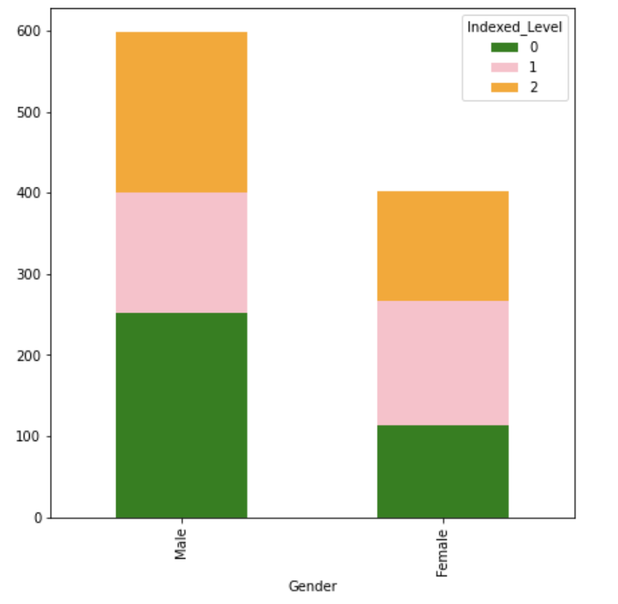
Gender Comparison of Data:
We used the Bar Plot for visualizing this data. The color green indicates the categorical value ‘0’ and pink and orange indicate ‘1’ and ‘2’ respectively.
This bar plot states that men have a higher risk than that Women. Out of the total rows, approximately 600 are men and 400 are of women.

Slide 7
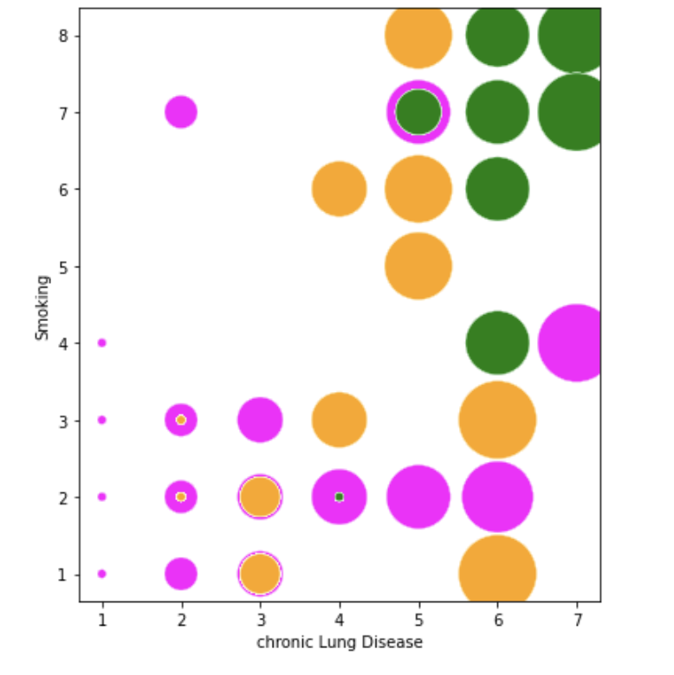
Frequency of smoking:
We used the bubble plot to understand whether a higher frequency of smoking leads to a higher rate of getting affected.
Here the x-axis represents the level of chronic lung disease and the y-axis refers to the frequency of smoking. The bubble plot states that a higher frequency of smoking leads to higher chances of being affected by cancer.

Slide 8
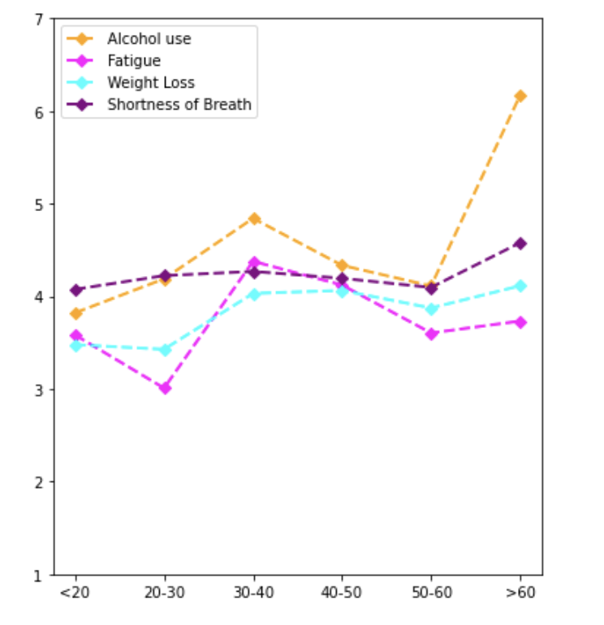
Issues experienced based on age:
To answer the question, do old people affect with cancer experience tendencies of weight loss, shortness of breath, and fatigue?
Age>50 has a higher chance of weight loss.
Aged 30-40 have higher fatigue chances as they deal with mental and physical stress.

Slide 9
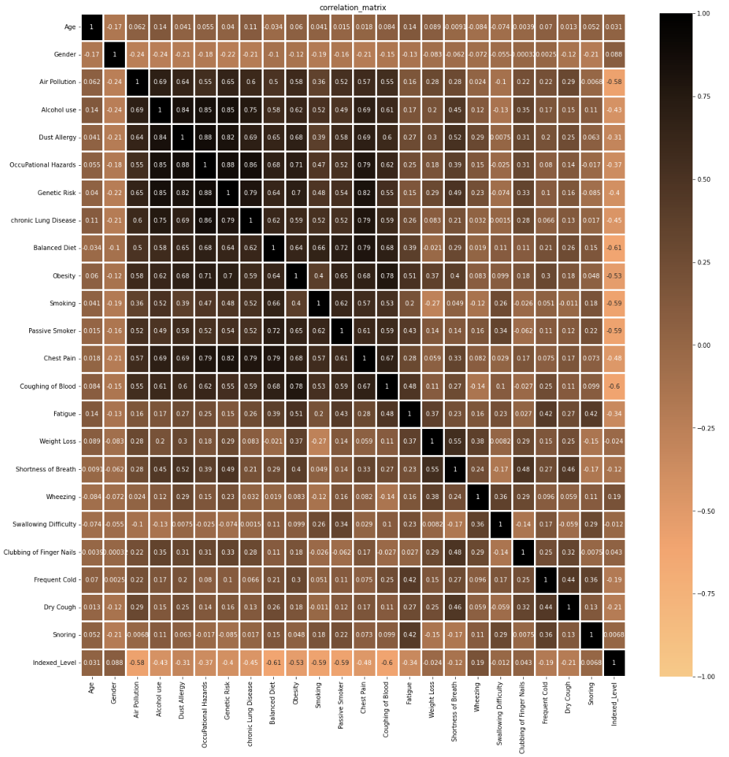
Correlation Matrix
Used heatmap to plot the columns, to understand the correlation between each one of them before we implement the Machine Learning models. This map helps us in understanding the positive, negative, and uncorrelated columns from the dataset.

Slide 10
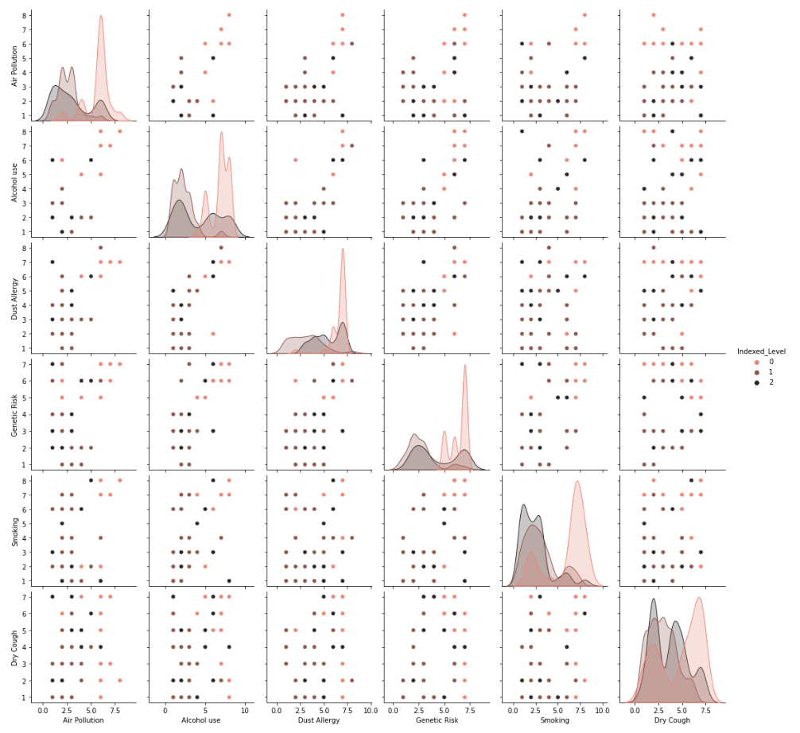
Pair Plot map
This is used to understand the best set of features to explain a relationship between two variables. We have considered the columns air pollution, alcohol use, dust allergy, genetic risk, smoking, and dry cough for pairwise plotting.

Slide 11
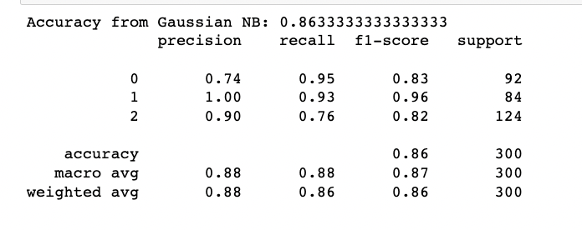
Machine Learning Models:
Splitting of the data into 70 and 30.
Adopted StandardScaler for analysis of data using machine learning models
Gaussian Naive Bayes is used when we have many independent variables, here in this dataset we have the many symptoms of lung cancer as independent variables and this model prediction resulted in an accuracy of 86%.

Slide 12
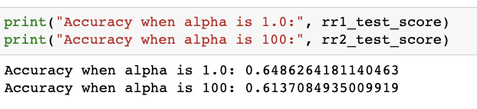
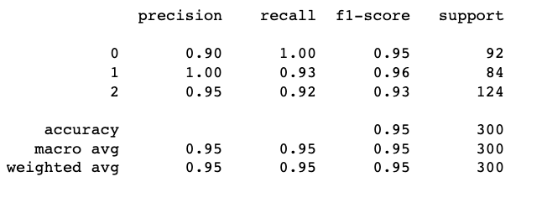
Ridge Regression Model is used to analyze the data with multicollinear. The dataset we consider exhibits multicollinearity and hence We have used a standard scaler to normalize the data and implemented the model considering the alpha values as 1.0 and 100 and recorded an accuracy of 64% and 61% respectively.
Linear Discrimination Analysis is used for supervised classification problems. This model works effectively on our data as we have target variables(high, medium, and low). As this model does not work with categorical variables, we have done indexing using a string indexer. This model resulted in an accuracy of 95%.

Slide 13
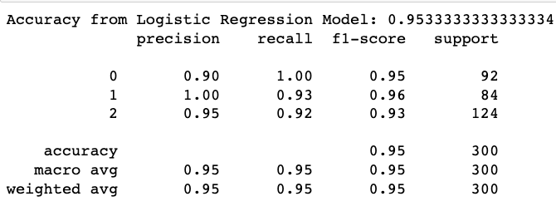
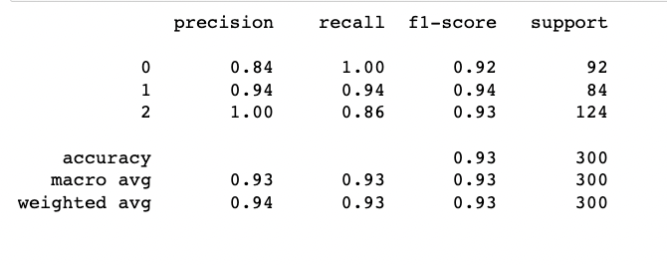
Logistic Regression Model is like linear regression, but this is fast and relatively uncomplicated. We have considered “liblinear” as a solver as it best suits our data with a random_state of 90. This the model resulted in an accuracy of 95%.
k-Nearest Neighbors is an algorithm using a Euclidean distance metric. We tried to implement cross-validation and also the grid search to find the best parameters. After considering the best parameter the analysis resulted in an accuracy of 93%.

Slide 14
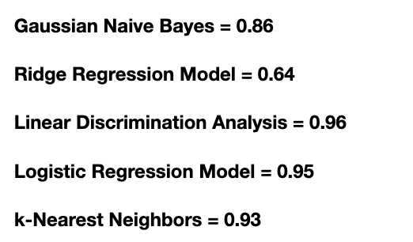
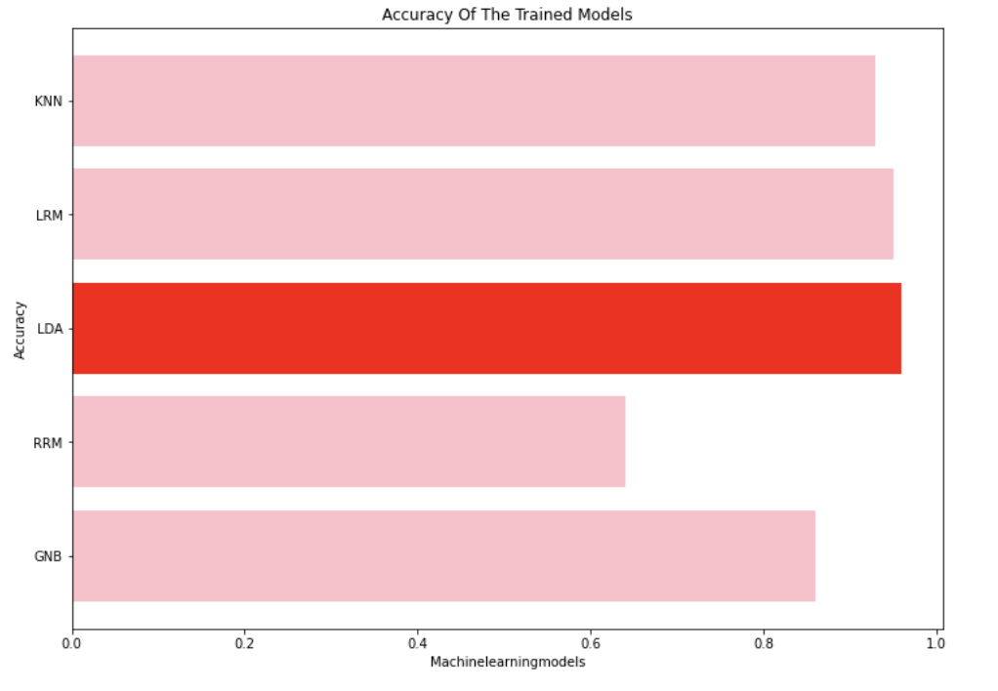
Accuracy scores from each model:
With the dataset selected, the Linear Discrimination model could produce 96% accuracy approximately which is higher than all other models, followed by the Logistic Regression model.

Slide 15
Thank you!

